Slide 1
Presentation On
“HEART DISEASE PREDICTION USING
MACHINE LEARNING TECHNIQUES”
Presented By:
Ms :Deokate Pritam Mohan Roll No:308
Ms :Kalel Aishwarya Anil Roll No:337
Ms :Pargave Savitra Bhimrao Roll No:352
Ms :Bankar Ashwini Shivaji Roll No:301
Guided By
Prof S.S.Nimbalkar
Department of Computer
Engineering

Slide 2
INTRODUCTION
Heart disease is the leading cause of death in the world over the past few years.
Several different symptoms are associated with heart disease, which makes it difficult to diagnose it quicker and better.
This issue can be resolved by adopting machine learning techniques.
Heart disease is the leading cause of death among all other disease, even cancers.

Slide 3
OBJECTIVE
Due lack of resources in the medical field, the prediction of heart disease occasionally may be a problem.
Utilization of suitable technology support in this regard can prove to be highly beneficial to the medical to the medical fraternity and patients.
The machine learning techniques can be very well adapted to do the prediction of heart disease.

Slide 4
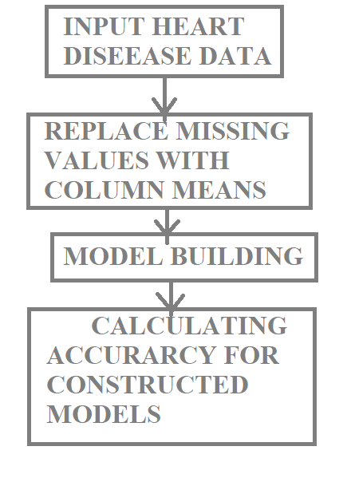
METHODOLOGY

Slide 5
Machine Learning
Machine Learning(ML) is the scientific study of algorithms and statistical models that computer system use to perform a specific task without using explicit instruction, relying on patterns and inference instead. It is seen as a subset of artificial intelligence.
Model/Algorithm used are:
K Neighbours Classifier

Slide 6
K Neighbours Classifier
It can be used for both classification and regression problems.
In both cases, the input consists of the k closest training examples in the feature space.
The output depends on whether k-NN is used for classification or regression.

Slide 7
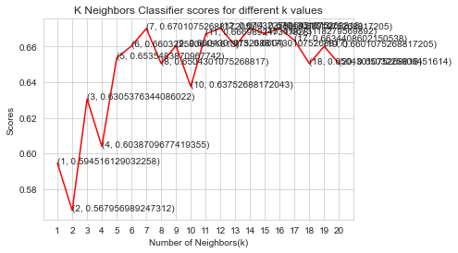

Slide 8
CONCLUSION
This involves analysis of the heart disease patient dataset with proper data processing.

